Slide 1
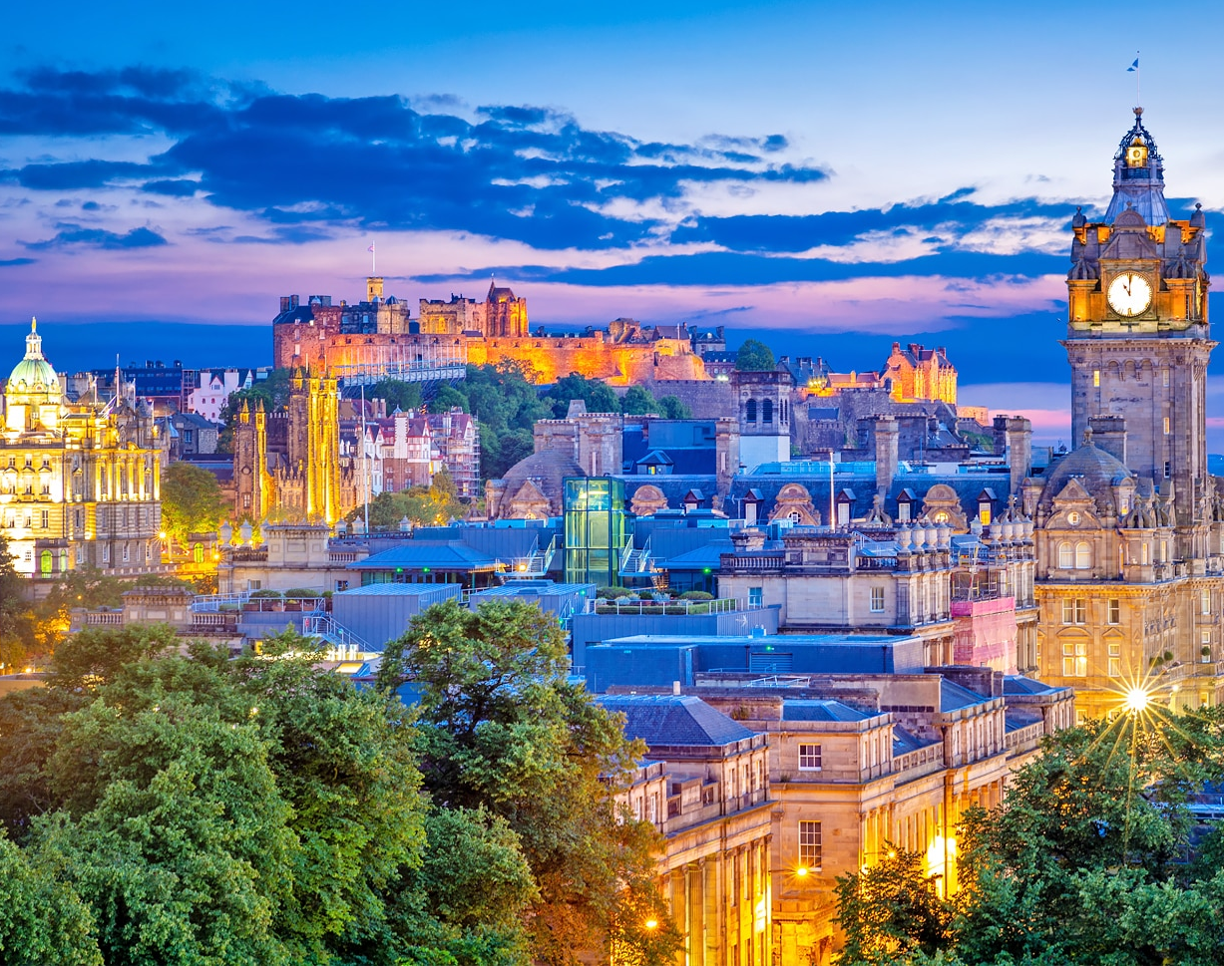
Edinburgh Residential
Year 6 Parent Information

Slide 2
Day 1
Departure
We will be leaving from Oxenholme train station on Monday 15th June. Train times are to be confirmed. Last year we arrived at station at 8am for 8.22 departure.
Accommodation
We will walk from the train station to the hostel, and the children will need to carry their own bags. This is a 15-minute walk. We will drop off our belongings at the hostel and walk to the first activity (25 min walk). Children will need parents to provide packed lunch for the first day.
National Museum of Scotland
Packed Lunches will be eaten in their lunchrooms then we will explore the museum – self guided.
Pizza Express and Cinema
We will return to the hostel for some down time before heading out for tea and cinema.

Slide 3
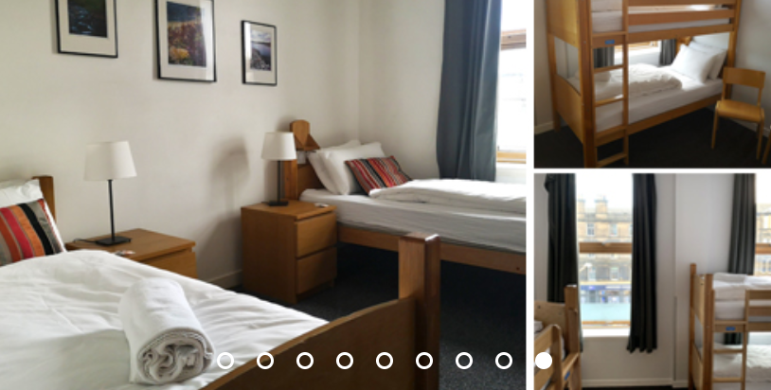
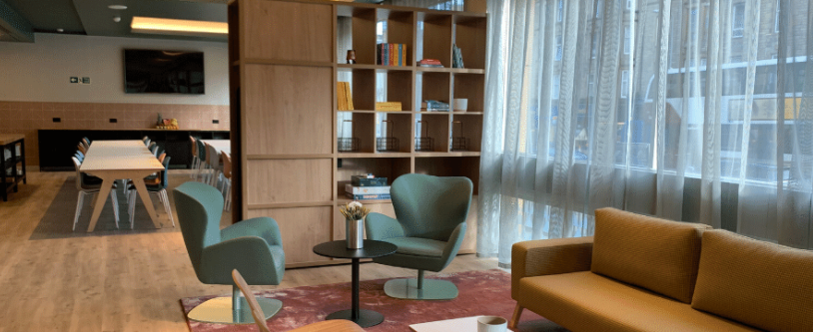
Accommodation and sleeping arrangements
https://www.hostellingscotland.org.uk/hostels/edinburgh-central/
This hostel has lots of experience taking youth groups and school groups so is well set up for it. There are large communal areas and dorms.
Girls and boys will be in separate dorms. All rooms are ensuite. The children will have akey to their rooms and the staff will also have a copy of a key for each room.
The 5 staff members (Mrs Jackson, Mrs Bigland, Mrs Towe and Mrs Edmondson and Miss Satterthwaite) will be in the room(s) on the same floor. We will ensure the children know where to come if they need anything. We will stay awake until all of the children are asleep. Lights out will vary depending on the day’s activities but will be approximately 9.30pm.

Slide 4
What to pack
Due to the walk between the hostel and the station, we recommend they wear a rucksack, which can then be used as a day-bag and also bring a holdall or suitcase preferably with wheels.
For the journey:
The journey will take 2 hours. We recommend that the children bring a snack for the journey and a book or some other form of non-electronic entertainment. Please ensure these are accessible easily (i.e. in their rucksack, not their suitcase). They will also need a packed lunch for day 1.
Change of clothes for each day – please ensure these are comfortable as we will be doing a lot of walking. We are hoping for beautiful sunny weather, but we will need to check the forecast and use this to be prepared for what we need to take. They will also need to be wearing comfortable shoes for this reason. They may also wish to bring a change of ‘smart’ clothes for the evening activities.
Coat/waterproof/layers
Pyjamas
Toiletries: face cloth, soap, toothbrush and toothpaste, shampoo/conditioner, hair ties
Towel
Sun cream
Sunglasses
Water bottle
Hat/cap
Snacks
Spending money (max £20)
Please do not pack electronics or mobile phones

Slide 5
Electronics and mobile phones
We are asking children not to take phones with them. This is primarily for safeguarding and insurance reasons, but we also strongly believe that not having phones with children will promote and develop their independence.
We understand that it may be difficult for our families not to feel that they have ‘instant access’ to children and vice versa. We know that parents will just want to make sure that their child is okay! For this reason, we make sure we send you updates via the school parentmail system. You can also contact us in an emergency via the school office. Please be reassured that if we need to contact parents for any reason, we do of course have the means to do so.
A form will go out nearer the time to ensure we have your up-to-date contact details alongside any medical information.

Slide 6
Day 2
Breakfast
We will wake the children up at approximately 8am to get washed, have breakfast, collect our packed lunches from the hostel and get ready to go out for the day. Edinburgh Central Hostel are providing a continental breakfast (cereal, toast, fruit, yoghurt). We will be departing the hostel by 9.30am.
Day 2 is a packed day with visits to 3 attractions: Dynamic Earth, Edinburgh Castle and Camera Obscura.
Packed lunches provided by the hostel will be eaten at Dynamic Earth.
Evening meal: Hard Rock Cafe
Evening entertainment: Bowling

Slide 7
Day 3
Breakfast
We will wake the children up at approximately 8am to get washed, have breakfast, collect our packed lunches from the hostel and get ready to go out for the day. Edinburgh Central Hostel are providing a continental breakfast. We will be departing the hostel by 9.40am.
Scottish National Galleries (20 minute walk from hostel and right next to the train station). We have a self guided tour booked from 10 – 11am.
We then usually spend some free time in the park by the station while we wait for our train.
Return train from Edinburgh Waverley approx 12pm
Lunch to be eaten on the train.
Arriving back in Oxenholme in the afternoon. Be aware your child will need picking up earlier than usual (approx. 2pm).
Exact timings for pick up and drop off will be provided once we have booked train tickets (this can only be done a few weeks in advance)

