Slide 1
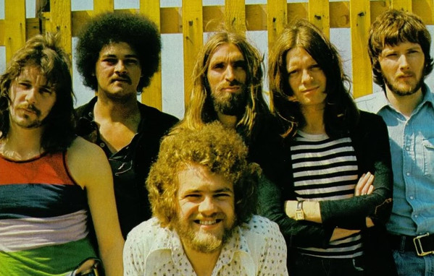
Stuck In The Middle With You –
Stealers Wheel

Slide 2

Well I don't know why I came here tonight,
I got the feeling that something ain't right,
I'm so scared in case I fall off my chair,
And I'm wondering how I'll get down the stairs,
Clowns to the left of me,
Jokers to the right, here I am,
Stuck in the middle with you.
Well you started out with nothing,
And you're proud that you're a self made man,
And your family all come crawlin,
Slap you on the back and say,
Please.... Please.....
Well I don't know why I came here tonight,
I got the feeling that something ain't right,
I'm so scared in case I fall off my chair,
And I'm wondering how I'll get down the stairs,
Clowns to the left of me,
Jokers to the right, here I am,
Stuck in the middle with you,
Yes I'm stuck in the middle with you,
Stuck in the middle with you,
Here I am, Stuck in the middle with you.

Slide 3
D
Well I don't know why I came here tonight,
I got the feeling that something ain't right,
G
I'm so scared in case I fall off my chair,
D
And I'm wondering how I'll get down the stairs,
A
Clowns to the left of me,
G D
Jokers to the right, here I am,
Stuck in the middle with you.
G
Well you started out with nothing,
D
And you're proud that you're a self made man,
G
And your family all come crawlin,
Slap you on the back and say,
D A D
Please.... Please.....

