Slide 1
Quiet As A Bulldog

Slide 3
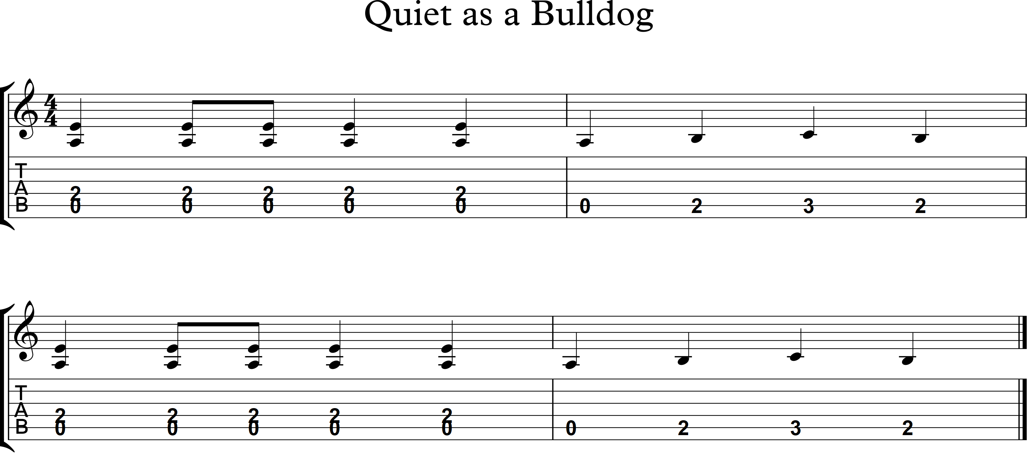

Slide 5


Slide 6


Slide 7


Slide 9



