Slide 1
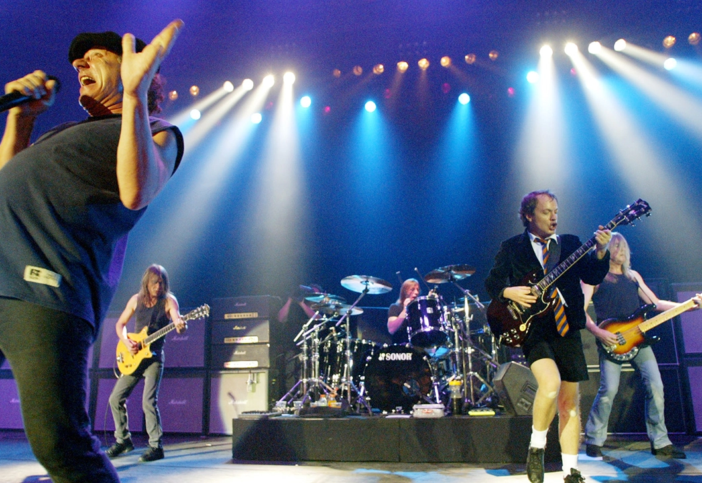
Back in Black by AC/DC

Slide 2

Back in black
I hit the sack
I've been too long, I'm glad to be back
Yes, I'm let loose
From the noose
That's kept me hanging about
I've been looking at the sky
'Cause it's gettin' me high
Forget the hearse 'cause I never die
I got nine lives
Cat's eyes
Abusin' every one of them and running wild
'Cause I'm back
Yes, I'm back
Well, I'm back
Yes, I'm back
Well, I'm back, back
Well, I'm back in black
Yes, I'm back in black

Slide 3
Back in black
I hit the sack
I've been too long, I'm glad to be back
Yes, I'm let loose
From the noose
That's kept me hanging about
I've been looking at the sky
'Cause it's gettin' me high
Forget the hearse 'cause I never die
I got nine lives
Cat's eyes
Abusin' every one of them and running wild
Riff= E DDD AAA
A E B A B
'Cause I'm back
A E B A B
Yes, I'm back
G D A G A
Well, I'm back
G D A G A
Yes, I'm back
A E B A B, A E B A B
Well, I'm back, back
G G G
Well, I'm back in black
D D D
Yes, I'm back in black
E

Slide 4
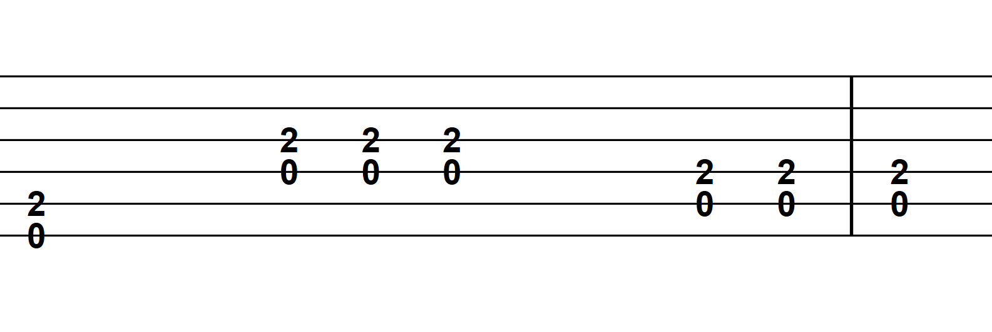

Slide 5
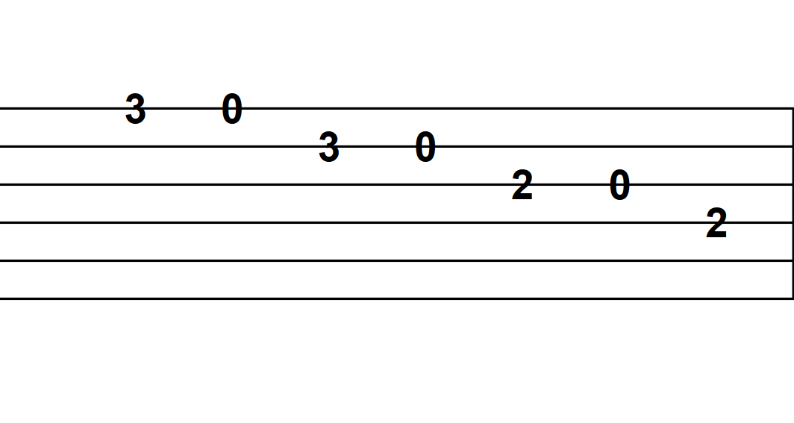

Slide 7
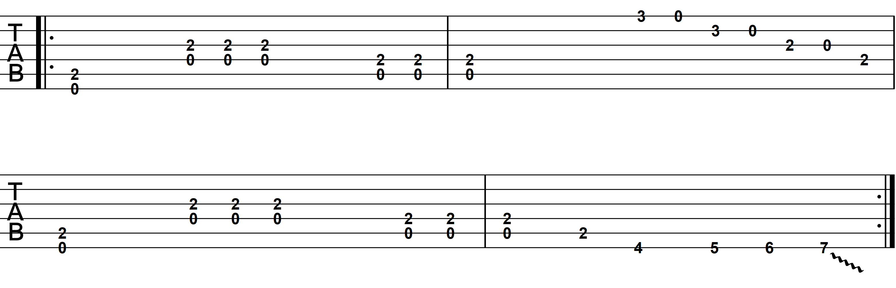

Slide 8
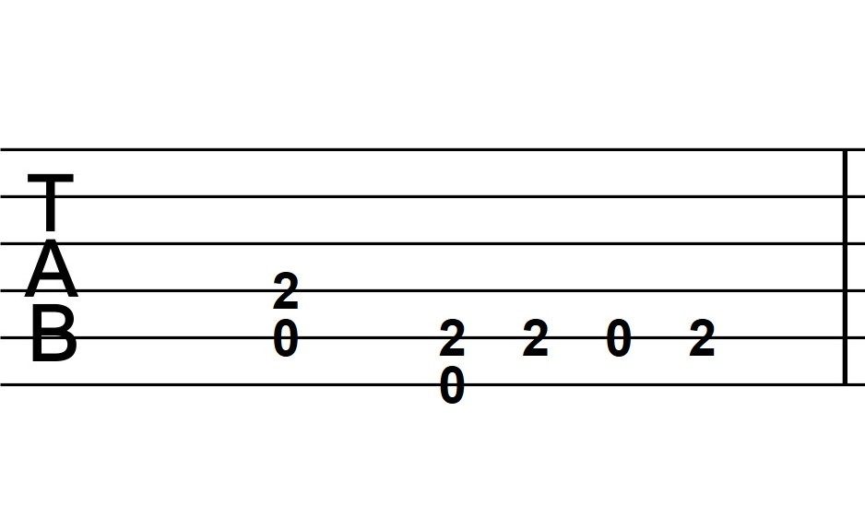

Slide 9
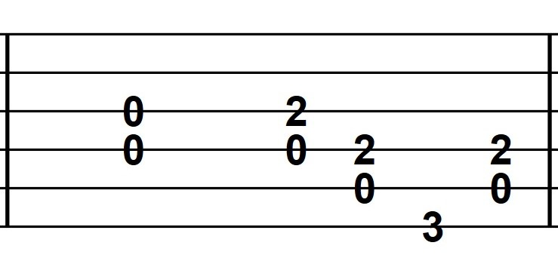

Slide 10
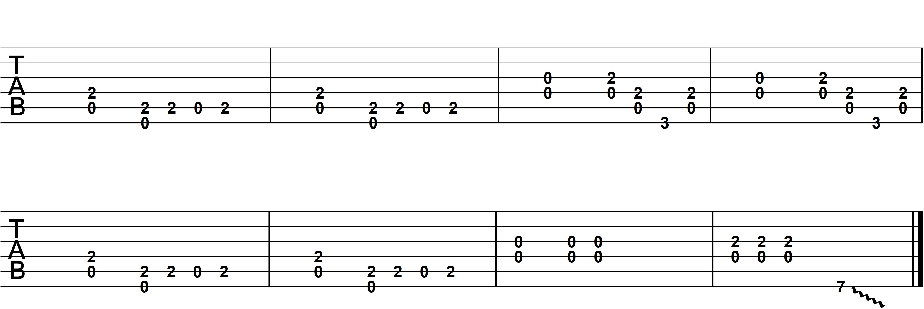

Slide 11
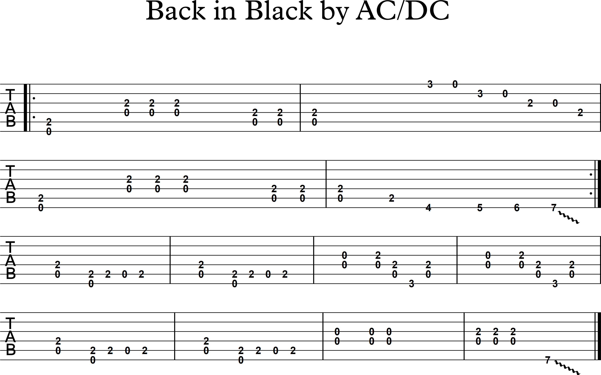

Slide 12
Back in black
I hit the sack
I've been too long, I'm glad to be back
Yes, I'm let loose
From the noose
That's kept me hanging about
I've been looking at the sky
'Cause it's gettin' me high
Forget the hearse 'cause I never die
I got nine lives
Cat's eyes
Abusin' every one of them and
running wild
'Cause I'm back
Yes, I'm back
Well, I'm back
Yes, I'm back
Well, I'm back, back
Well, I'm back in black
Yes, I'm back in black

