Slide 1
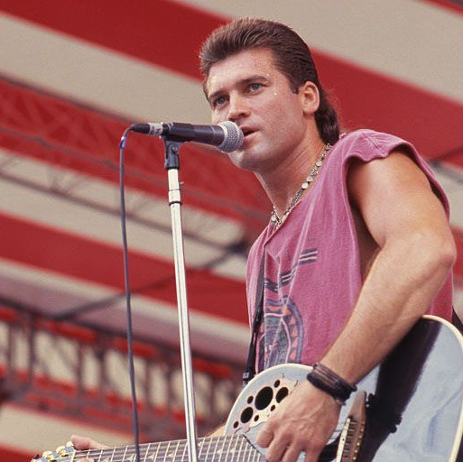
Billy Ray Cyrus-
Achy Breaky Heart

Slide 2

You can tell the world you never was my girl
You can burn my clothes up when I'm gone
Or you can tell your friends just what a fool I've been
And laugh and joke about me on the phone
You can tell my arms go back to the farm
You can tell my feet to hit the floor
Or you can tell my lips to tell my fingertips
They won't be reaching out for you no more
But don't tell my heart, my achy breaky heart
I just don't think he'd understand
And if you tell my heart, my achy breaky heart
He might blow up and kill this man
Ooh
You can tell your ma I moved to Arkansas
Or you can tell your dog to bite my leg
Or tell your brother Cliff who's fist can tell my lips
He never really liked me anyway
Or tell your Aunt Louise, tell anything you please
Myself already knows I'm not okay
Or you can tell my eyes to watch out for my mind
It might be walking out on me one-day
But don't tell my heart, my achy breaky heart
I just don't think he'd understand
And if you tell my heart, my achy breaky heart
He might blow up and kill this man
Ooh
But don't tell my heart, my achy breaky heart
I just don't think he'd understand
And if you tell my heart, my achy breaky heart
He might blow up and kill this man
Don't tell my heart, my achy breaky heart
I just don't think he'd understand
And if you tell my heart, my achy breaky heart
He might blow up and kill this man
Ooh

Slide 3
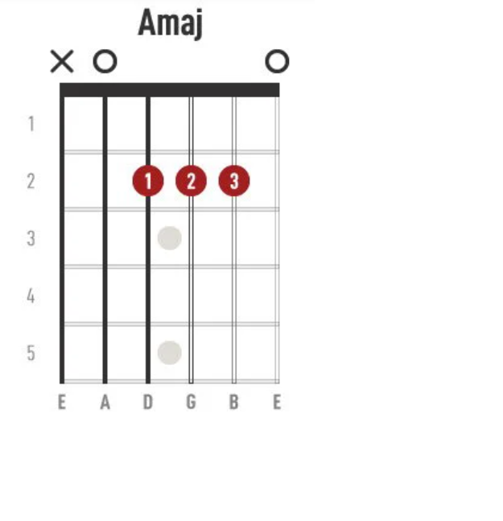
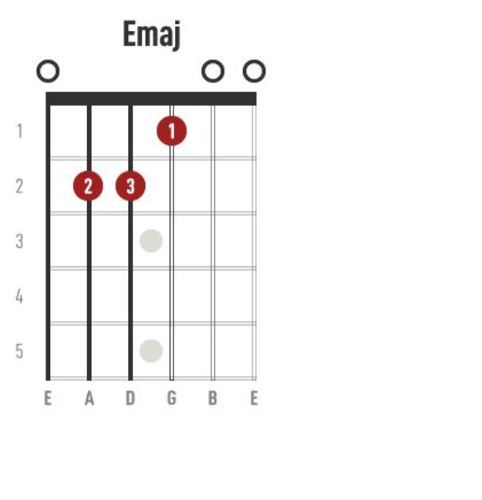

Slide 4
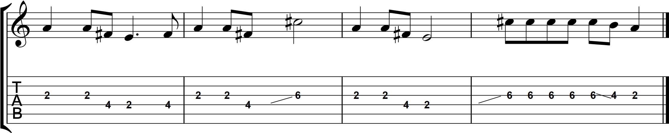
Intro

Slide 5
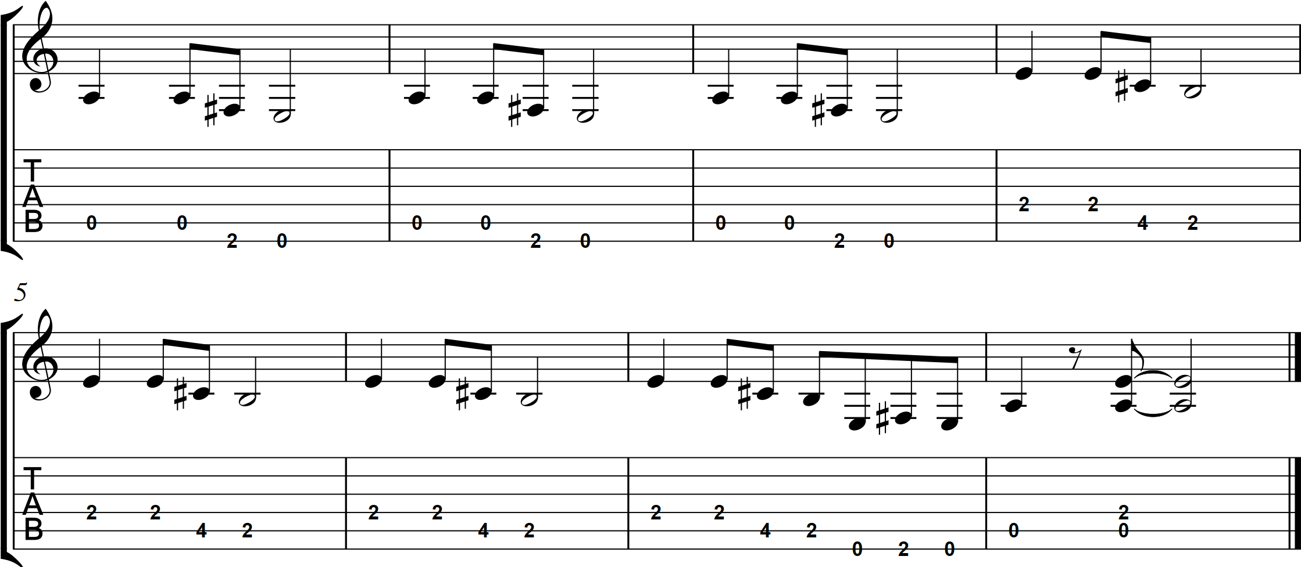
Guitar solo

Slide 6
You can tell the world you never was my girl
You can burn my clothes up when I'm gone
Or you can tell your friends just what a fool I've been
And laugh and joke about me on the phone
You can tell my arms go back to the farm
You can tell my feet to hit the floor
Or you can tell my lips to tell my fingertips
They won't be reaching out for you no more
But don't tell my heart, my achy breaky hear
I just don't think he'd understand
And if you tell my heart, my achy breaky heart
He might blow up and kill this man
Ooh
You can tell your ma I moved to Arkansas
Or you can tell your dog to bite my leg
Or tell your brother Cliff who's fist can tell my lips
He never really liked me anyway
Or tell your Aunt Louise, tell anything you please
Myself already knows I'm not okay
Or you can tell my eyes to watch out for my mind
It might be walking out on me one-day
But don't tell my heart, my achy breaky heart
I just don't think he'd understand
And if you tell my heart, my achy breaky heart
He might blow up and kill this man
Ooh
(Solo)
(repeat chorus x2)
(repeat solo x2)

