Slide 1
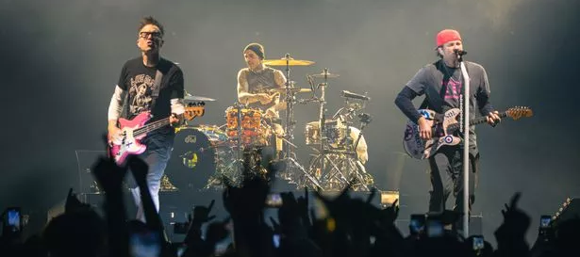
Blink182 – All the Small Things

Slide 2

All the small things
True care, truth brings
I'll take one lift
Your ride, best trip
Always, I know
You'll be at my show
Watching, waiting
Commiserating
Say it ain't so
I will not go
Turn the lights off
Carry me home
Na-na, na-na, na-na, na-na, na, na
Na-na, na-na, na-na, na-na, na, na
Na-na, na-na, na-na, na-na, na, na
Na-na, na-na, na-na, na-na, na, na
Late night, come home
Work sucks, I know
She left me roses by the stairs
Surprises let me know she cares
Just say it ain't so
I will not go
Turn the lights off
Carry me home
Na-na, na-na, na-na, na-na, na, na
Na-na, na-na, na-na, na-na, na, na
Na-na, na-na, na-na, na-na, na, na
Na-na, na-na, na-na, na-na, na, na

Slide 3
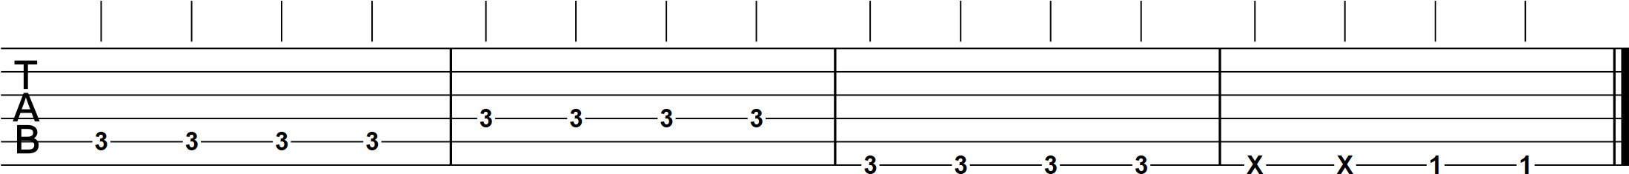
All the small things (super easy-peasy version)
Intro
x2

Slide 4
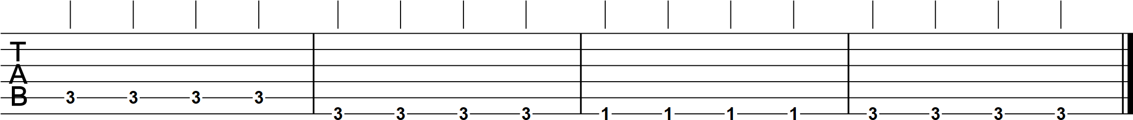
Verse
x4

Slide 5
Bridge

Slide 6
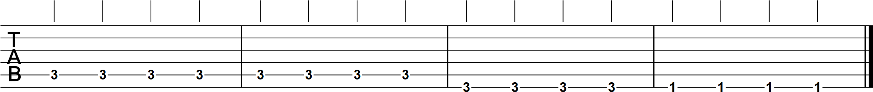
Chorus
x2

Slide 7
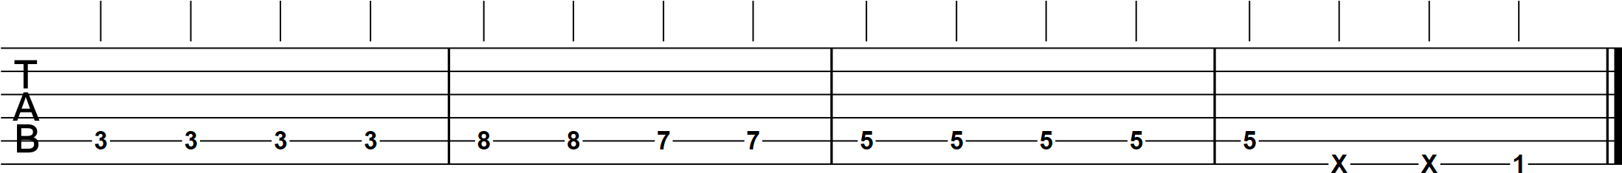
Guitar break
x2

Slide 8
x2
x4
(x2 on the repeat)
x2
x2

Slide 9
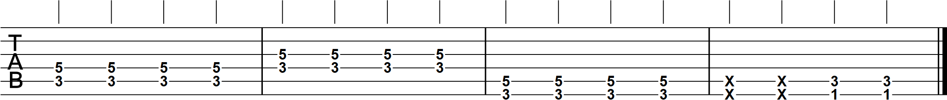
All the small things (slightly trickier version)
Intro
x2

Slide 10
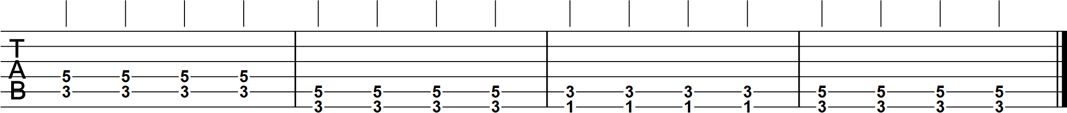
Verse
x4

Slide 11
Bridge

Slide 12
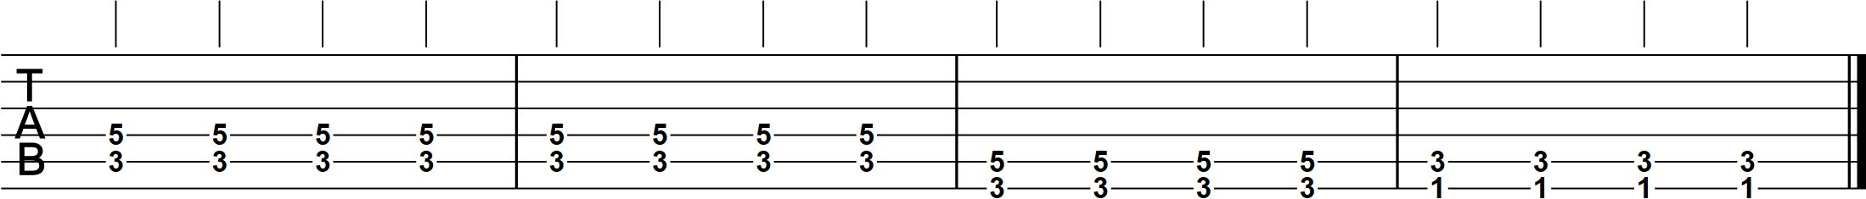
Chorus
x2

Slide 13
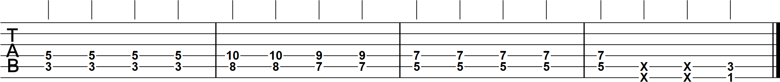
Guitar break
x2

Slide 14
x2
x4
(x2 on the repeat)
x2
x2

