Slide 1
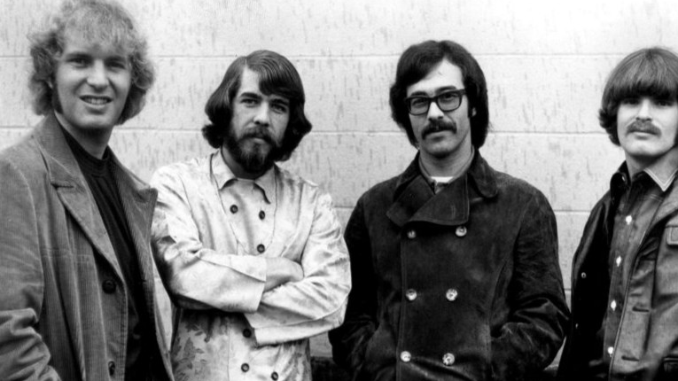
Bad Moon Rising
Creedence Clearwater Revival

Slide 2

I see the bad moon a-risin'
I see trouble on the way
I see earthquakes and lightnin'
I see bad times today
Don't go around tonight
Well it's bound to take your life
There's a bad moon on the rise
I hear hurricanes a-blowin'
I know the end is comin' soon
I fear rivers over flowin'
I hear the voice of rage and ruin
Don't go around tonight
Well it's bound to take your life
There's a bad moon on the rise, alright
Hope you got your things together
Hope you are quite prepared to die
Looks like we're in for nasty weather
One eye is taken for an eye
Well don't go around tonight
Well it's bound to take your life
There's a bad moon on the rise
Don't come around tonight
Well it's bound to take your life
There's a bad moon on the rise

Slide 3
D A G D
I see the bad moon a-risin'
I see trouble on the way
I see earthquakes and lightnin'
I see bad times today
G
Don't go around tonight
D
Well it's bound to take your life
A G D
There's a bad moon on the rise
D A G D
I hear hurricanes a-blowin'
I know the end is comin' soon
I fear rivers over flowin'
I hear the voice of rage and ruin
G
Don't go around tonight
D
Well it's bound to take your life
A G D
There's a bad moon on the rise, alright
Hope you got your things together
Hope you are quite prepared to die
Looks like we're in for nasty weather
One eye is taken for an eye
Well don't go around tonight
Well it's bound to take your life
There's a bad moon on the rise
Don't come around tonight
Well it's bound to take your life
There's a bad moon on the rise

Slide 4




Slide 5
D A G D
I see the bad moon a-risin'
I see trouble on the way
I see earthquakes and lightnin'
I see bad times today
G
Don't go around tonight
D
Well it's bound to take your life
A G D
There's a bad moon on the rise
D A G D
I hear hurricanes a-blowin'
I know the end is comin' soon
I fear rivers over flowin'
I hear the voice of rage and ruin
G
Don't go around tonight
D
Well it's bound to take your life
A G D
There's a bad moon on the rise, alright
Hope you got your things together
Hope you are quite prepared to die
Looks like we're in for nasty weather
One eye is taken for an eye
Well don't go around tonight
Well it's bound to take your life
There's a bad moon on the rise
Don't come around tonight
Well it's bound to take your life
There's a bad moon on the rise

