Slide 1
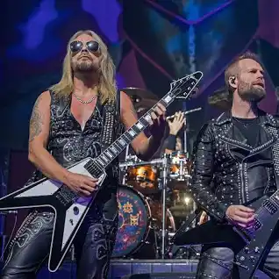

Breaking the Law
Judas Priest

Slide 2

There I was completely wasting, out of work and down
All inside it's so frustrating as I drift from town to town
Feel as though nobody cares if I live or die
So I might as well begin to put some action in my life
Breaking the law, breaking the law
Breaking the law, breaking the law
Breaking the law, breaking the law
Breaking the law, breaking the law
So much for the golden future, I can't even start
I've had every promise broken, there's anger in my heart
You don't know what it's like, you don't have a clue
If you did you'd find yourselves doing the same thing too
Breaking the law, breaking the law
Breaking the law, breaking the law
Breaking the law, breaking the law
Breaking the law, breaking the law
You don't know what it's like
Breaking the law, breaking the law
Breaking the law, breaking the law
Breaking the law, breaking the law
Breaking the law, breaking the law

Slide 3
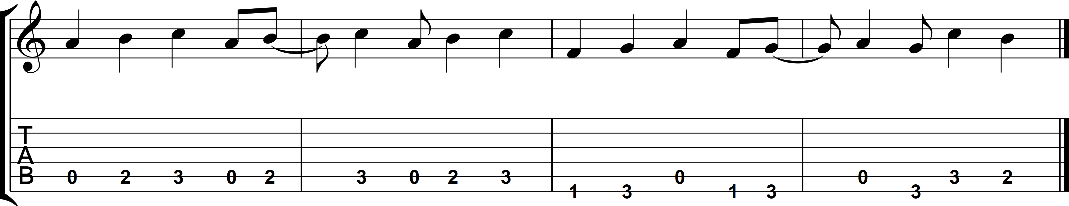
Riff

Slide 4
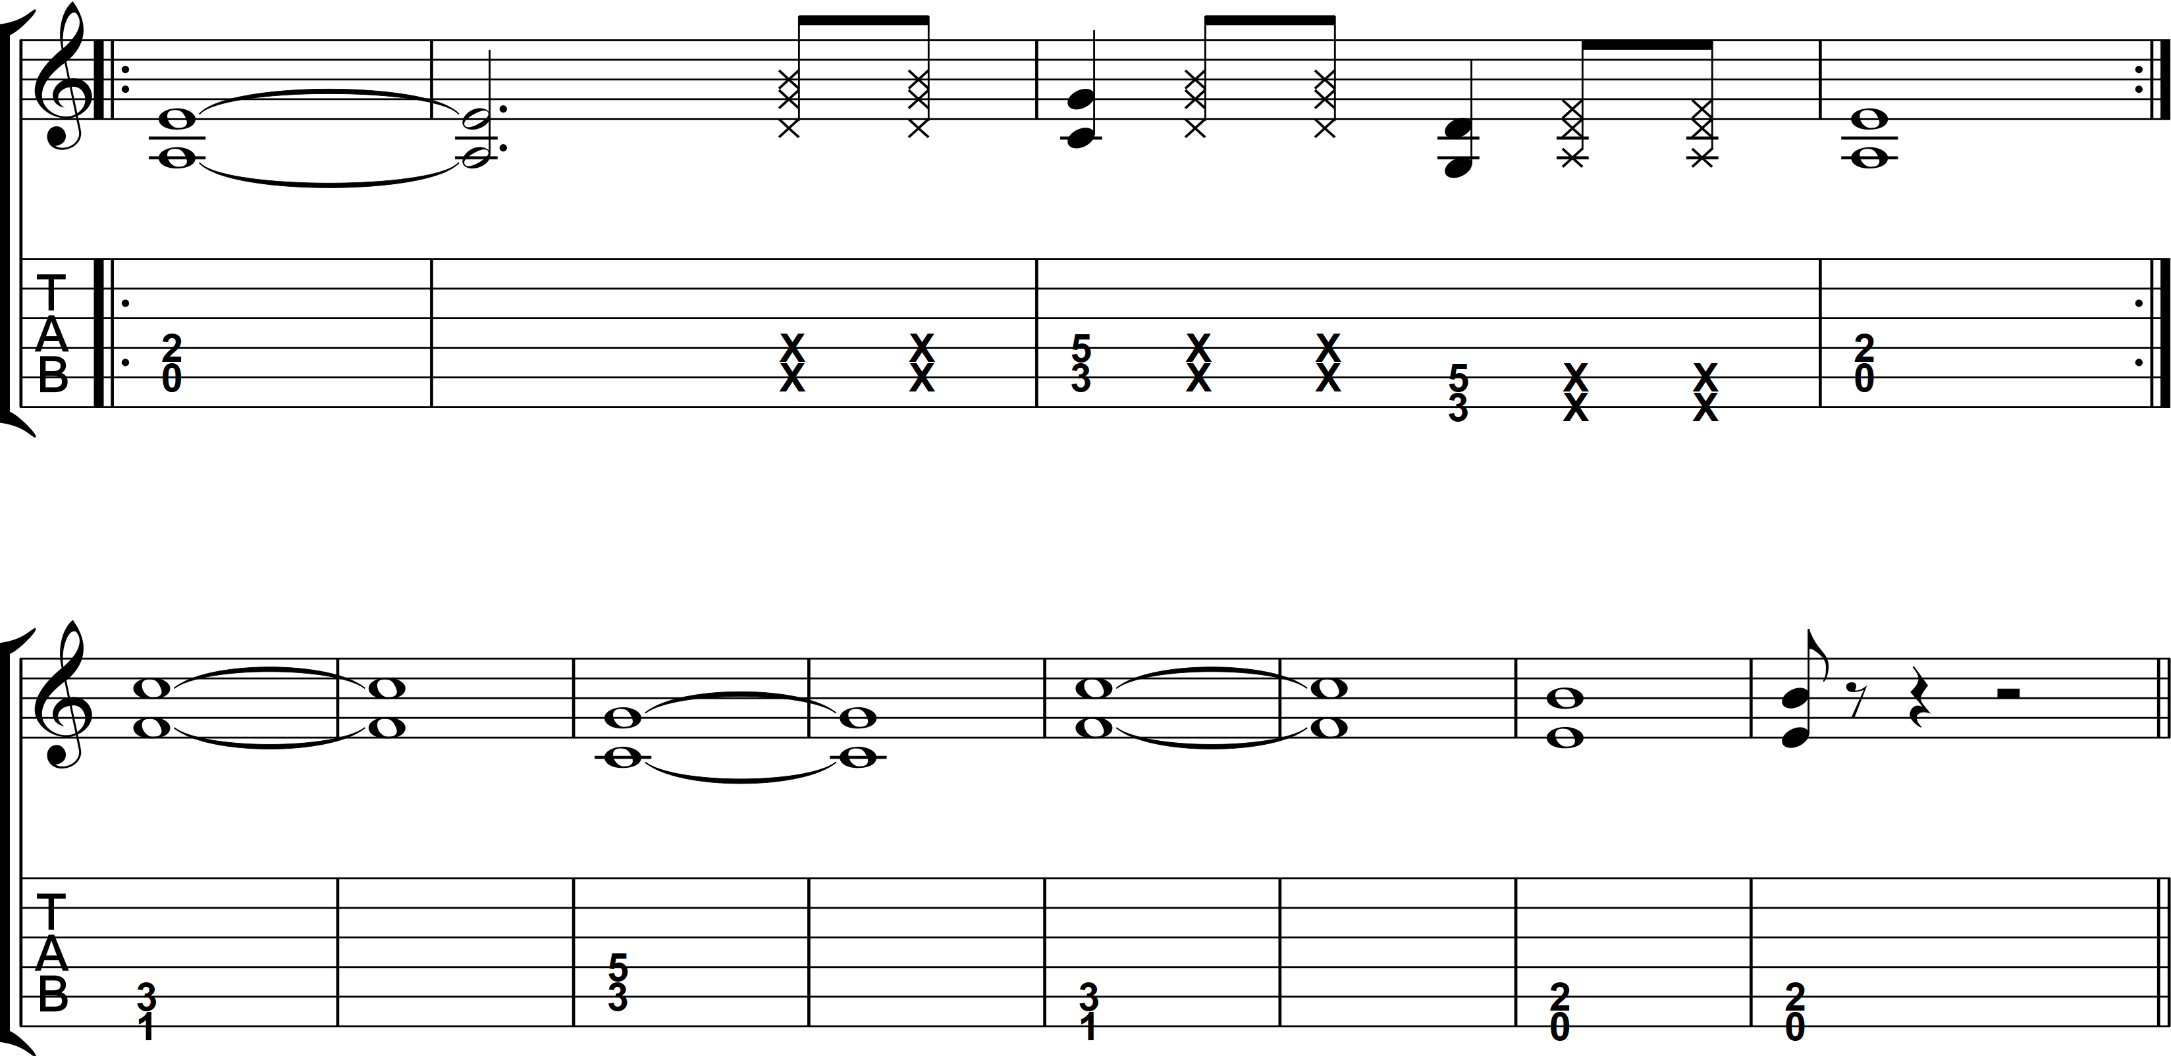
Verse and Bridge

Slide 5
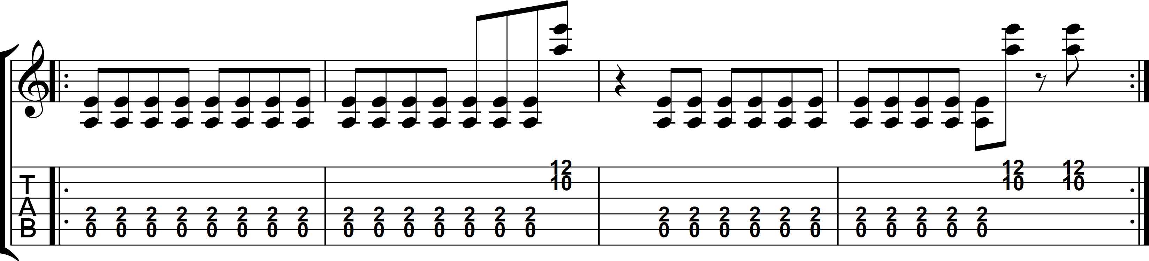
Chorus

Slide 6


